Slide 1
Incoherent Ray Tracing without Acceleration Structures
Attila Áfra
Budapest University of Technology, Hungary
Babeș-Bolyai University, Romania
Notes:
Hi, I’m Attila Áfra from Budapest University of Technology, and I will now present my paper about incoherent ray tracing without acceleration structures.

Slide 2
Divide-and-conquer ray tracing
Recently introduced
[Keller and Wächter 2011]
[Mora 2011]
Does not use any acceleration structures!
Competitive performance
Input: set of rays, set of objects
Almost 0 temporary memory usage
Notes:
Divide-and-conquer ray tracing is a recently introduced alternative to traditional ray tracing methods. It doesn’t use any acceleration structures, but despite this, its performance is quite competitive. The inputs of the algorithm are simply the set of rays and the set of objects to intersect. It uses almost no temporary memory.

Slide 3
Algorithm
Rays
Triangles
0
1
2
3
4
5
6
7
A
B
C
D
E
F
G
H
Notes:
The algorithm basically traverses a virtual acceleration structure.

Slide 4
Algorithm – Bounding volume
Rays
Triangles
0
1
2
3
4
5
6
7
A
B
C
D
E
F
G
H
Notes:
First, we compute the bounding box of the triangles…

Slide 5
Algorithm – Ray filtering
Rays
Triangles
1
2
4
5
7
3
6
0
A
B
C
D
E
F
G
H
Notes:
… and determine the list of active rays, which are the rays that intersect the bounding box. This operation is called ray filtering.

Slide 6
Algorithm – Object partitioning
Rays
Triangles
1
2
4
5
7
3
6
0
A
B
C
D
E
F
G
H
Notes:
Then, we partition the list of triangles…

Slide 7
Algorithm – Object partitioning
Rays
Triangles
1
2
4
5
7
3
6
0
B
C
E
G
H
F
D
A
Notes:
… into two sublists.

Slide 8
Algorithm – Recursion
Rays
Triangles
1
2
4
5
7
3
6
0
B
C
E
G
H
F
D
A
Notes:
The intersection continues recursively with the two partitions. If a certain termination criterion is met, the rays are directly intersected with the triangles.

Slide 9
New method
Divide-and-conquer ray tracer
Optimized for incoherent rays
Goal: efficient cache and SIMD utilization
Optimized for 8-wide SIMD
AVX (Advanced Vector Extensions)
Successor of SSE
Intel Sandy Bridge (2011)
Notes:
The new method I propose is based on divide-and-conquer ray tracing and is optimized for incoherent rays. The goal is to achieve efficient cache and SIMD utilization, which is crucial for high performance. The method is also optimized for 8-wide SIMD execution by using the new AVX instruction set, which was introduced with the Intel Sandy Bridge CPUs.

Slide 10
Ray filtering
Large ray array (millions of rays)
Filtering partitions it into: active, inactive rays
Active rays intersect the current AABB
Reorders ray data
Reordering indices is slower for incoherent rays
Efficient cache usage
Linear memory accesses
Cache space not wasted
Notes:
The rays are stored in a large array which typically contains millions of rays. Ray filtering partitions this array into two parts: active rays and inactive rays. It reorders directly the ray data, which, for incoherent rays, is faster than reordering an index array because of the more efficient cache usage. This way, the memory accesses are linear and cache space is not wasted.

Slide 11
Ray data layout
Should be compact to reduce bandwidth usage
32 bytes
Fits exactly into an AVX register → SIMD-friendly
Fast moves (one instruction)
Origin (o)
Direction (d)
Reciprocal direction not stored, too expensive
Hit distance (t)
Frequently accessed, should not be kept separately
ID
Required to identify reordered rays
o_{x}
o_{y}
o_{z}
t
d_{x}
d_{y}
d_{z}
id
Notes:
The ray data structure is as compact as possible to reduce the required memory bandwidth. Its size is 32 bytes, so it fits exactly into a single AVX register. This has some important performance benefits like faster SIMD computation and data movement. The structure contains the origin, the direction vector, the nearest intersection distance, and a ray ID which is necessary to identify the reordered rays. The reciprocal direction, which is used for the ray-box intersections is not precomputed because it would be too expensive to store.

Slide 12
Ray-box intersection
SIMD: 8 rays with 1 AABB
Requires rays in SoA layout
Convert from AoS with SIMD loads and shuffles
AABB computed during triangle partitioning
Avoids an extra sweep over the triangles
Notes:
To speed up the ray-box intersections, 8 rays are intersected with 1 box at the same time using SIMD. This requires the rays to be in structure-of-arrays format, but they are stored in an array of structures. Thanks to the SIMD-friendly ray layout, the data can be efficiently gathered and rearranged using SIMD load and shuffle operations.
The axis-aligned bounding box that is tested against the rays is not computed right before the intersections, but it is computed during a previous triangle partitioning step. This saves an additional sweep over the triangles.

Slide 13
Triangle partitioning
BVH-like object list partitioning
Disjoint partitions (like quicksort)
Reorders a triangle ID array
Precomputed triangle AABB array
SIMD-optimized layout
Two partitioning methods
Middle partitioning (spatial median) → fast
SAH partitioning (binned) → slower, but higher-quality
Notes:
The triangle partitioning is based on BVH-like object list partitioning, which has a useful property that it produces disjoint partitions. We reorder a triangle ID array, and use precomputed AABBs in SIMD format to speed up the computations. We use two different partitioning methods: middle partitioning, which is fast, and SAH partitioning which is slower but higher-quality.

Slide 14
Adaptive partitioning
Takes into account the ray distribution
High-quality partitioning only where it makes sense
Not possible with prebuilt acceleration structures!
Method selected according to ray/triangle ratio
SAH partitioning only if ratio > 1-2
Very simple and works quite well
Notes:
An adaptive partitioning strategy is used, which takes into account the actual ray distribution. We want to use high-quality partitioning only in those parts of the scene where it is beneficial, so we switch between SAH and middle partitioning. This optimization is not possible with traditional ray tracing methods because the acceleration structure is built without prior knowledge about the ray distribution.
We select the partitioning method according to ratio of the number of active rays and the number of triangles in the current group. SAH partitioning is used only if this ratio is larger than a predefined threshold (for example, a value between 1 and 2).

Slide 15
Adaptive partitioning
SAH
Middle
Notes:
In this example, the group of triangles on the left will be partitioned using SAH because there are lots of rays. However, for the group on the right, middle partitioning will be used.

Slide 16
Ray-triangle intersection
Stop partitioning if too few rays or triangles
Threshold: 8
Intersect all rays with all triangles
SIMD: 8 rays with 1 triangle
Compact triangle array
AABB array already contains 6 vertex coords per triangle
Store only the remaining 3 coords and shuffle info
Notes:
If the number of rays or triangles gets below a predefined threshold, the triangles are directly intersected with the rays without further partitioning. SIMD is used to intersect 8 rays with 1 triangle in parallel. The triangles are stored in a compact form. The AABB array used for fast triangle partitioning already encodes 6 of the vertex coordinates of each triangle, so we only have to store the remaining 3 coordinates and some shuffle information necessary to reconstruct the triangles.

Slide 17
Multithreading
Trace N ray batches in parallel
Simple, no synchronization, but…
Suboptimal
Many triangle partitioning steps are performed multiple times
Not a big problem in practice!
Partitioning usually only 10-20% of total runtime
Notes:
The current implementation uses a very simple and commonly used multithreading approach: tracing N independent ray batches in parallel, one on each thread. This doesn’t need any synchronization, but it is not an optimal solution. There are many triangle partitioning steps which will be repeatedly carried out by different threads. Fortunately, this is not a big issue in practice because triangle partitioning constitutes only a small part of the total runtime: about 10-20%.

Slide 18
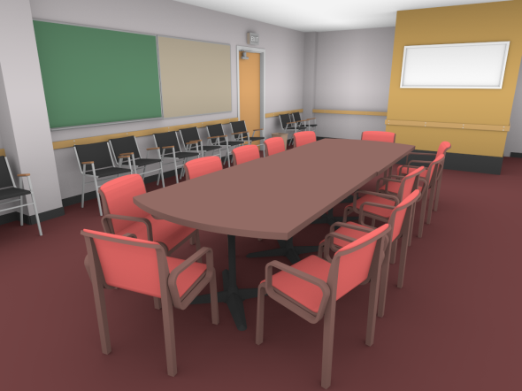
Results
Conference Room
282K triangles
New method
[Mora 2011]
8-bounce diffuse path tracing
Notes:
And now let’s see the results. This slide shows the ray tracing performance in million rays per second for the 8-bounce diffuse path tracing of the Conference Room scene.
The new method, on the Nehalem CPU architecture that supports only SSE, outperforms the only other existing divide-and-conquer ray tracer, especially on a single thread. We can see that AVX provides a major speedup over SSE in singlethreading mode, but surprisingly, it is slower using multithreading. It is important note that the Sandy Bridge CPU used in the test has a somewhat lower peak memory bandwidth than the Nehalem. This suggests that the algorithm is limited by the available bandwidth.

Slide 19
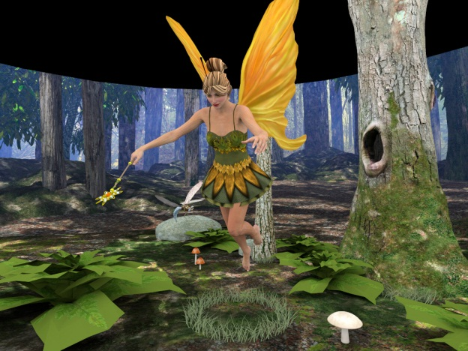
Results
Fairy Forest
174K triangles
New method
MBVH8
Timings do not include MBVH build!
Sandy Bridge 3.4GHz
Notes:
In this other benchmark I’ve compared my method against a state-of-the-art MBVH ray tracer with a prebuilt acceleration structure. This means that the MBVH timings did not include the construction. Even so, the new method gets quite close to the MBVH on a single thread. However, the difference is larger on multiple threads: it’s twice slower than the static ray tracer.

Slide 20
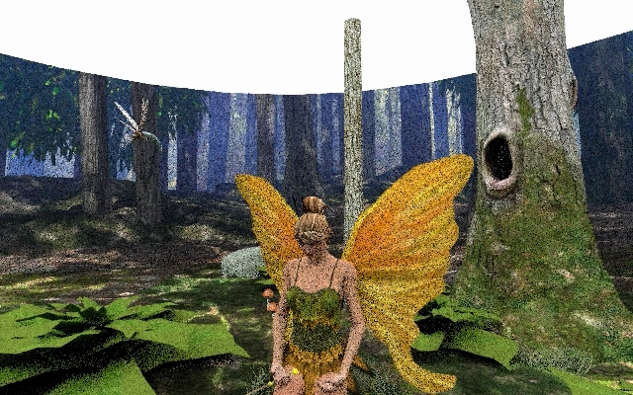
Demo: Fairy Forest
Core i7-2600, 2-bounce diffuse, 640x400, 8 spp → 8 Mray/s
Notes:
Here we can see a real-time recorded animation of the Fairy Forest scene running on an Intel Core i7-2600 CPU. The scene is rendered using 2-bounce diffuse path tracing with 8 paths per pixel. The ray tracing performance is about 8 million rays per second.

Slide 21
Conclusions
The method is still quite experimental
Elegant, easy to use!
Not much slower than traditional ray tracing
With prebuilt acceleration structures!
Interesting applications
Adaptive tessellation, augment rasterization, etc.
Future work
Reduce memory traffic: ray compression, pre-sorting?
More efficient multithreading
GPU
Notes:
The presented method is still in an experimental phase. However, even in it’s current form, it’s an elegant algorithm which can be used as easily as any rasterization API. We’ve seen that in most cases it’s not much slower than state-of-the-art static ray tracers with prebuilt acceleration structures. I think that in certain cases sacrificing some performance for a much cleaner rendering architecture is a good trade-off. Also, divide-and-conquer ray tracing could have some very interesting applications like ray-adaptive tessellation and augmenting rasterization-based renderers.
The primary bottleneck of the algorithm is memory bandwidth, which is one of the major problems that must be solved in the future. Possible solutions could be compressing the ray data and/or presorting the rays. Developing a more efficient multithreading approach and adapting the algorithm to the GPU are also important research directions.

Slide 22
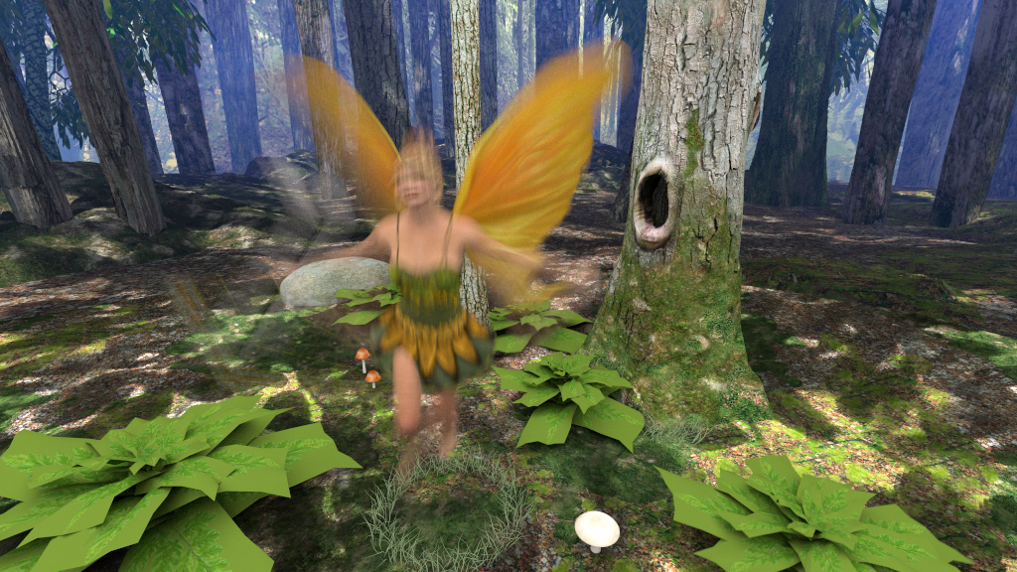
Thank you!
Questions?

